Slide 1
Secure Data Hiding in Image Using Steganography
CAPSTONE PROJECT
Presented By: Rakshit Patial
Student Name : Rakshit Patial
College Name & Department : Jain University & MCA Cybersecurity

Slide 2
OUTLINE
Problem Statement
Technology used
Wow factor
End users
Result
Conclusion
Git-hub Link
Future scope

Slide 3
Problem Statement
Efficiently embedding characters into image pixel values without compromising image integrity.
Managing different color channels (Red, Green, Blue) for message encoding.
Providing feedback through a real-time log console.
Ensuring compatibility across Windows, macOS, and Linux.
Offering a visually attractive and hacker-themed modern GUI to make the tool appealing for cybersecurity
enthusiasts.

Slide 4
Technology used
Python Version 3.12
OpenCV
Pillow
Image
Tkinter
Ttk
Pychram

Slide 5
Wow factors
User Friendly GUI
Cross-Platform Compatibility
Supports Multiple Image Formats
Image Preview with Resizing
Log Saving Feature
Progress Bar Feedback
Real-Time Log Console
Dual Theme Toggle (Dark/Light Mode)
Live Character Count Tracking

Slide 6
End users
Cybersecurity Professionals
Journalists & Whistleblowers
Law Enforcement & Intelligence Agencies
Cryptographers & Security Researchers
Privacy-Conscious Users
Digital Forensics Teams
Educators & Students
Military & Defence Organizations
Medical & Healthcare Organizations

Slide 7
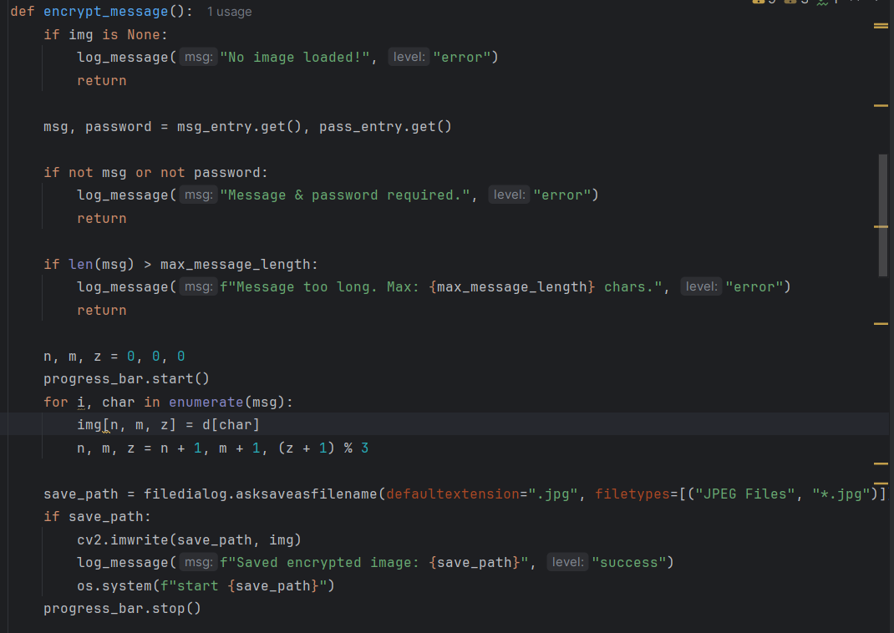
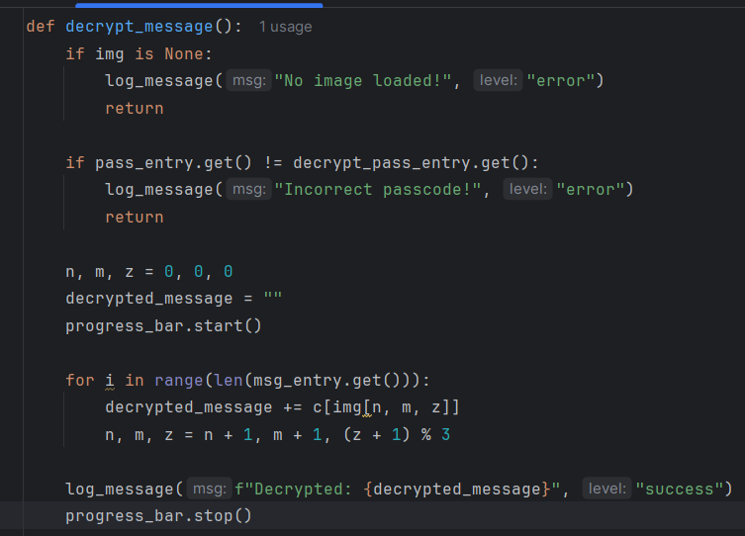
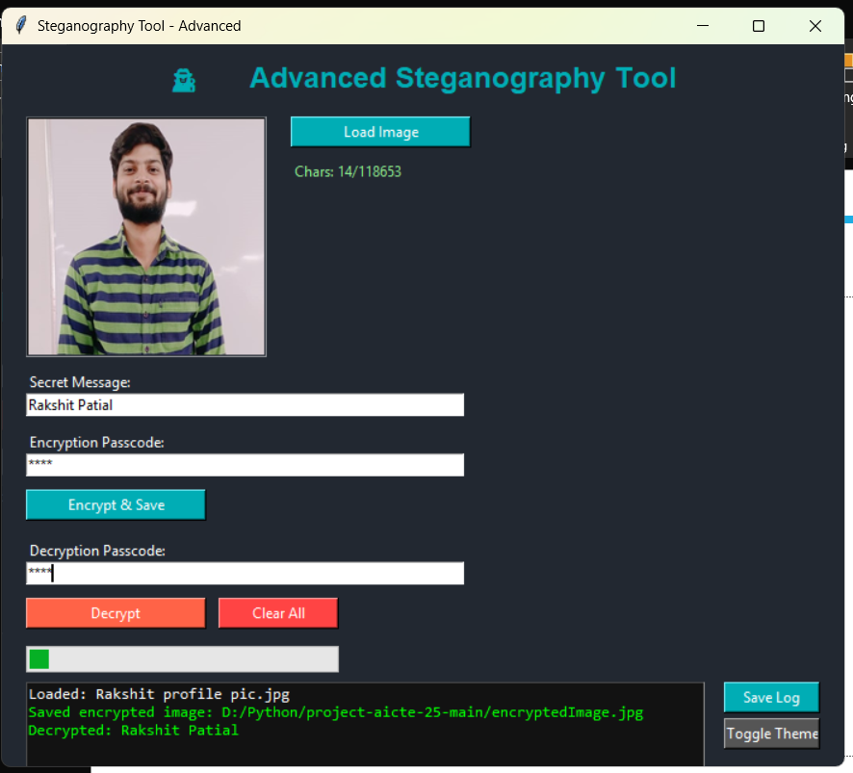
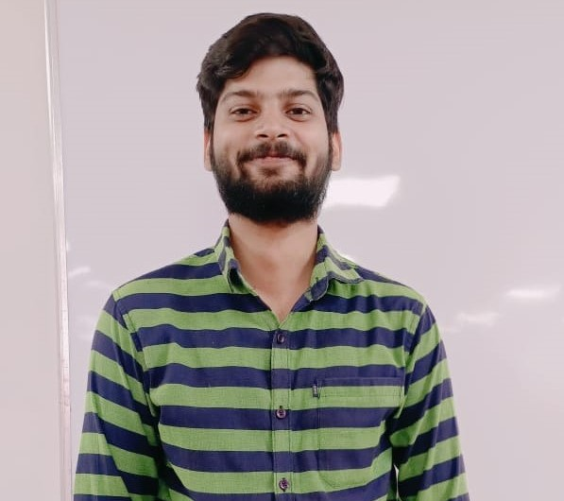

Results
Encryption Code: Decryption Code: GUI:
Input Image: Encrypted Image:

Slide 8
Conclusion
The Steganography Tool - Advanced provides a secure and user-friendly solution for embedding secret messages within images. By combining simple encryption techniques with an intuitive graphical interface, it allows users to hide, save, and retrieve confidential information discreetly. With its flexibility, real-time feedback, and customizable themes, the tool is not only useful for personal privacy but also for secure communications in professional environments. As digital data security becomes increasingly important, tools like this play a crucial role in safeguarding sensitive information and enabling safe, covert communication in a wide range of applications.

Slide 9
GitHub Link
https://github.com/Raks8899/Steganography_Tool_python/tree/main -

Slide 10
Future scope(optional)
Support for multiple file formats (BMP, TIFF, GIF, audio files like MP3, WAV, etc.)
Integration of advanced encryption algorithms (AES-256, RSA, ECC)
Implementation of steganalysis-resistant techniques (random pixel embedding)
Batch processing for multiple images/messages at once
Cloud integration (Google Drive, Dropbox) for secure sharing and cloud storage
Development of mobile app (Android & iOS) and web-based version
Message compression to embed longer messages in smaller images
Real-time collaborative encryption and decryption sessions
Multi-language support (UTF-8 for all character sets)

Slide 11
THANK YOU

